Slide 1

Dynamically Made RNN

Slide 2
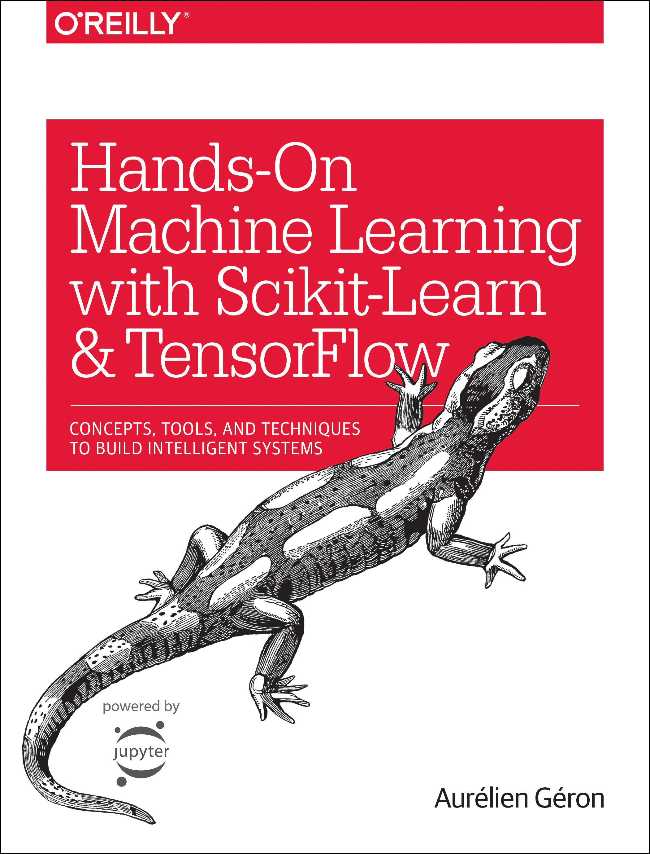
Reference
Chapter 14 (O'Reilly) of Hands-On ML
Youtube
Code

Slide 3
Data

Slide 4
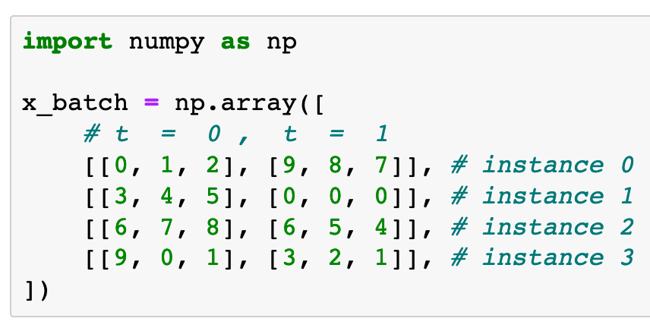

Slide 5
Graph

Slide 6
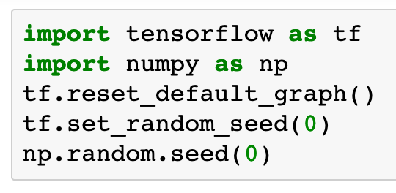

Slide 7
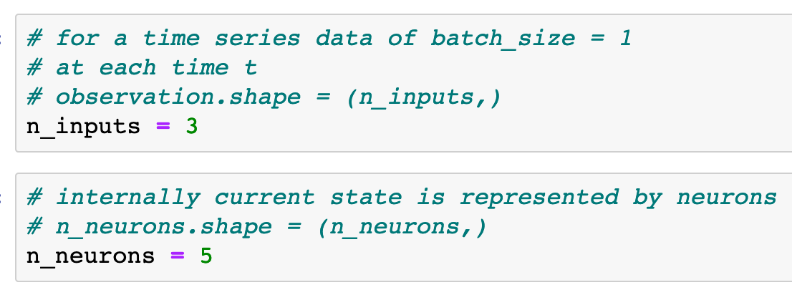


Slide 9
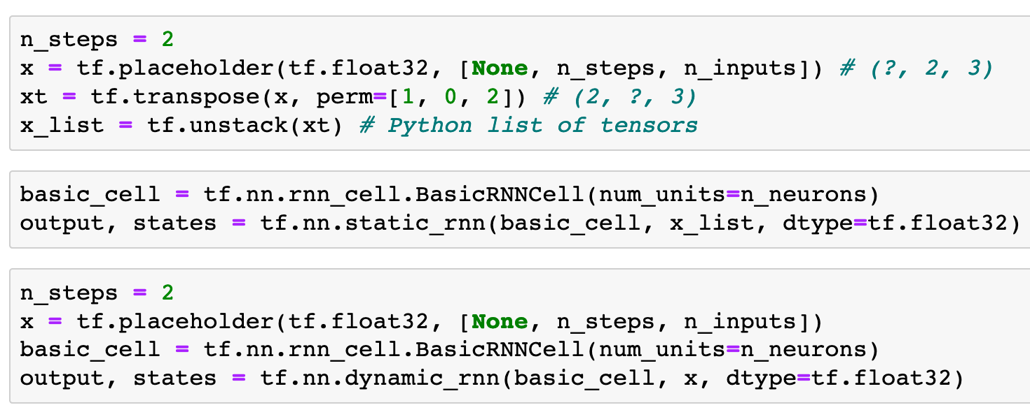
Previously
Now

Slide 10
Previously
Now

Slide 11
Previously
Now

Slide 12
Previously
Now

Slide 13
Previously
Now

Slide 14
Previously
Now

Slide 15
List of Tensors
Previously
Now

Slide 16
List of Tensors
Previously
Now
Tensor

Slide 17
List of Tensors
List of Tensors
Previously
Now
Tensor

Slide 18
List of Tensors
List of Tensors
Previously
Now
Tensor
Tensor

Slide 19
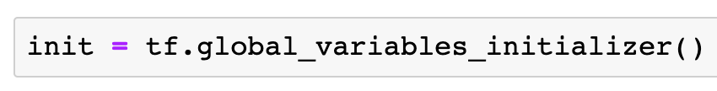

Slide 20
Session

Slide 21
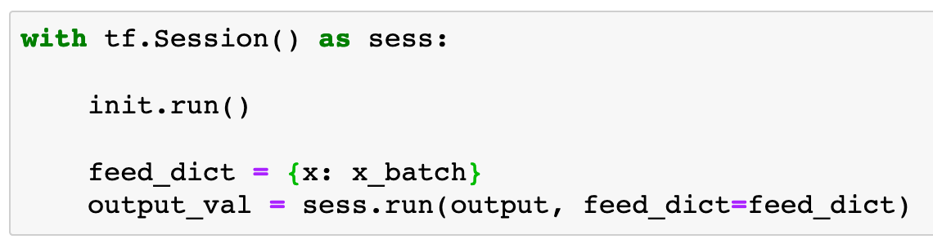

Slide 22
Report

Slide 23
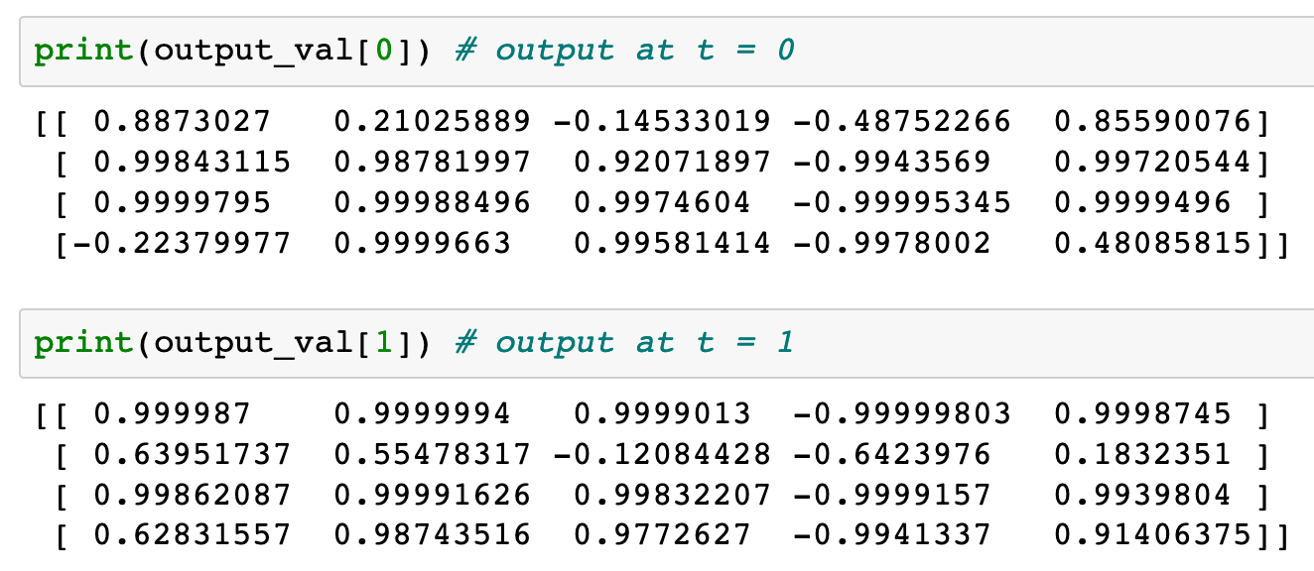
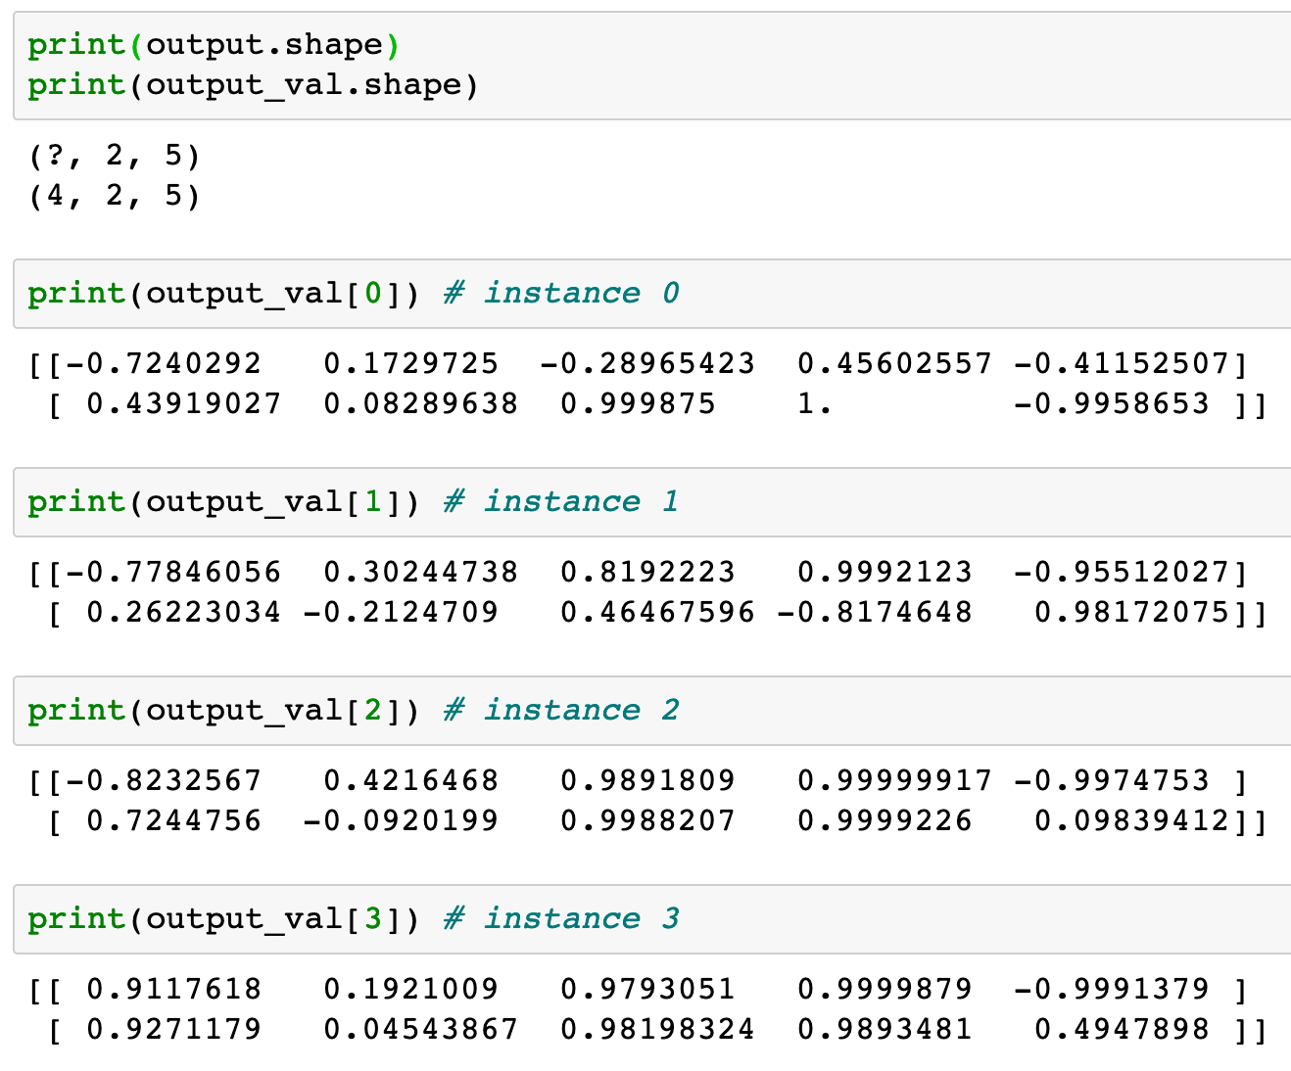
Previously
Now

Slide 24
Previously
Now

Slide 25
Previously
Output of
Tensors List
Now

Slide 26
Previously
Output of
Tensors List
Now
Output of
Tensor

Slide 28
Static RNN
packs both input and output as list.
Dynamic RNN
removes transpose and unstack,
handles both input and output as tensor.

Slide 29
Now
Let’s Play with Code

